Slide 1

A HOTTER PLANET, HIGHER SEAS
Project Team: Clarissa Nunez, DJ Dimetros, Jacob Klucher, Toni Makakoa, Mohamoud Jama
BootCamp: UofM-VIRT-DATA-PT-09-2024-U-LOLC-MTTH
November 19, 2024

Slide 2

THE ASK?
What is the current state of global warming and climate change?
How much has the Earth’s average temperature increased since the pre-industrial era?
How much has sea level risen in the past century?
How much has CO2 emissions changed over the years?

Slide 3

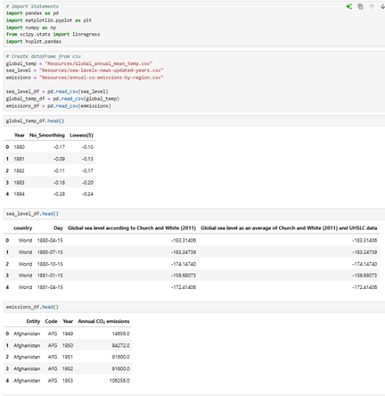
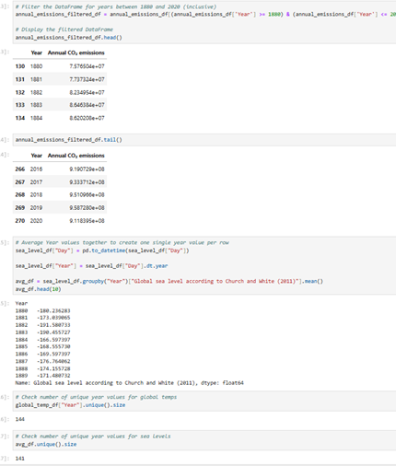
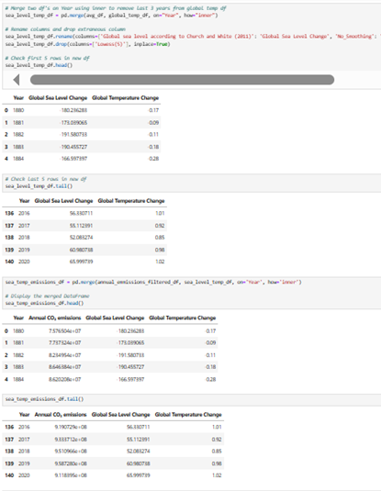
DATA EXPLORATION AND CLEAN UP
HANDLE MISSING VALUES AND OUTLIERS
FORMAT AND PREPROCESS THE DATA FOR VISUALIZATION

Slide 4
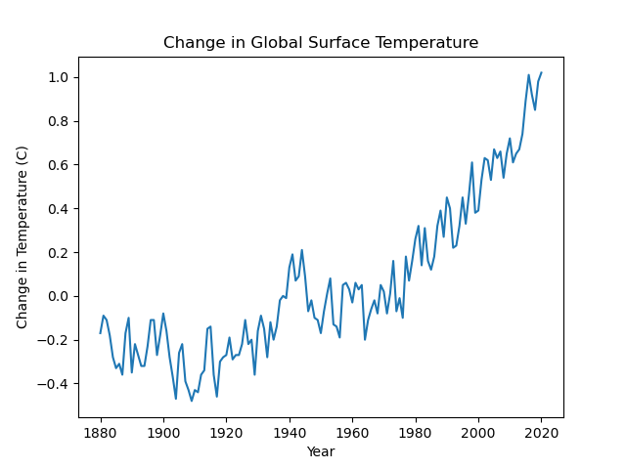
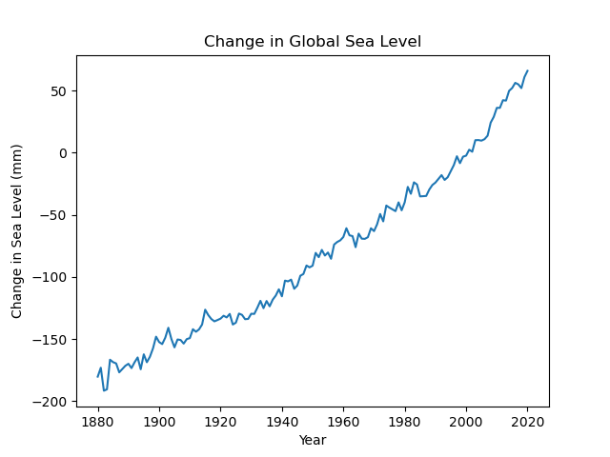
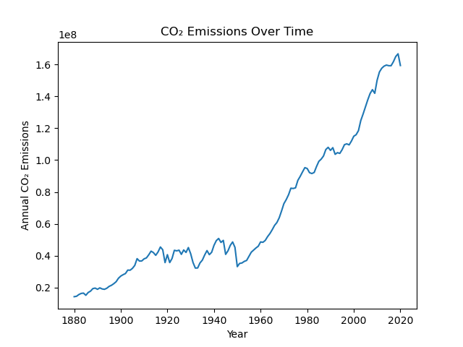
CLIMATE CHANGES OVER TIME
Global temperatures have risen steadily since the late 19th century, with the rate of increase accelerating in recent decades.
Global sea levels have been climbing year after year since 1880, a trend that has accelerated in recent decades.
Since 1880, the concentration of carbon dioxide (CO₂), in Earth’s atmosphere has risen significantly.
Notes:
Global temperatures have risen steadily since the late 19th century, with the rate of increase accelerating in recent decades. Key trends:
1880-1910: There was relatively little change in global temperatures during this period, which was part of a longer phase of moderate warming and cooling. Natural climate variability, such as volcanic activity and solar radiation fluctuations, influenced the temperature.
1910-1940: Temperatures began to rise slowly during this period, although the warming was not as pronounced as in later decades.
1940-1970: There was a period of relative cooling or slower warming, likely due to increased industrial pollution (aerosols) reflecting sunlight, as well as natural variability. This period is sometimes referred to as the "mid-century cooling."
1970s-present: After the 1970s, global temperatures began to rise sharply. This period has seen an accelerated warming, primarily driven by human activities, especially the burning of fossil fuels and deforestation, which have increased concentrations of greenhouse gases in the atmosphere.
3:26
1880-1940: Sea levels rose gradually, at an average rate of about 1.0-1.5 millimeters per year. This was largely due to the thermal expansion of water and the melting of glaciers.
1940-1980: The rate of sea level rise continued to be slow, but the trend remained upward. Human-induced warming was beginning to influence the rate of change, but the effects were not as dramatic as those seen after the 1980s.
1980-present: Sea levels have risen more rapidly, with the rate accelerating to about 3.3 millimeters per year on average from 1993 to the present (this rate has been increasing, and in some areas, rates are higher than average).
Since 1880, the concentration of carbon dioxide (CO₂) in Earth's atmosphere has risen significantly.

Slide 5

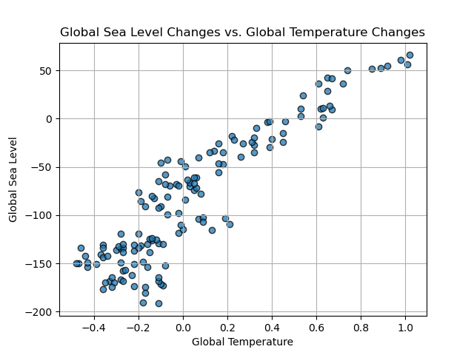
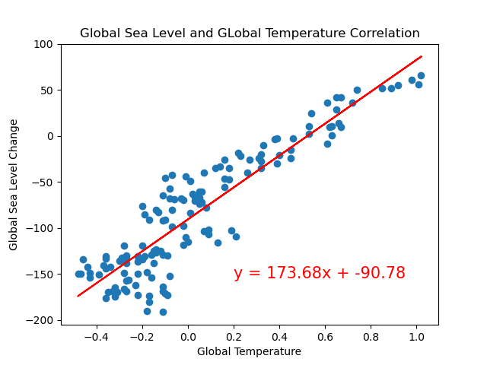
SEA LEVEL vs TEMP ANALYSIS
Sea Level vs Temperature
Can temperature changes and sea level changes be linked if they are both increasing steadily overtime?
About 83% of the variation in sea level changes can be explained by changes in global temperature.
There is a strong correlation between sea level changes and global temperature
Approximately 17% of the variation is unexplained by the model
R² value of 0.8299 ( ~0.83) indicates strong correlation between sea level changes & global temperature.
Notes:
Looking at the line graph that corresponds to temperatures overtime we can also see a steady increase in average global temperatures since 1880. This leads us to think, might temperature changes and sea level changes be linked if they are both increasing steadily overtime? In order to answer this question, we created some comparisons between sea level and global temperature and what we found out is that as global temperatures increase, global sea level changes are also increasing. Using a regression, we deduces an R^2 value of 0.8299 (or approximately 0.83) which indicates a strong correlation between sea level changes and global temperature. This value suggests that about 83% of the variation in sea level changes can be explain by changes in global temperature. Since this value is rather high, we can also conclude that approximately 17% of the variation is unexplained by the model, which could be attributed to other factures that influence seal level like other various level dynamics and ice melt

Slide 6
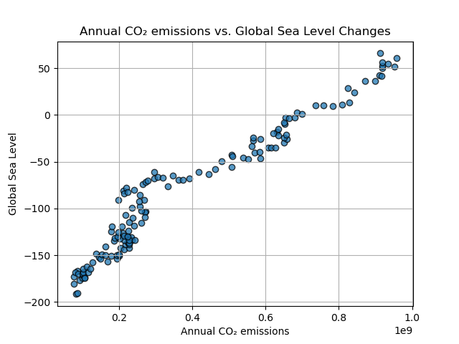
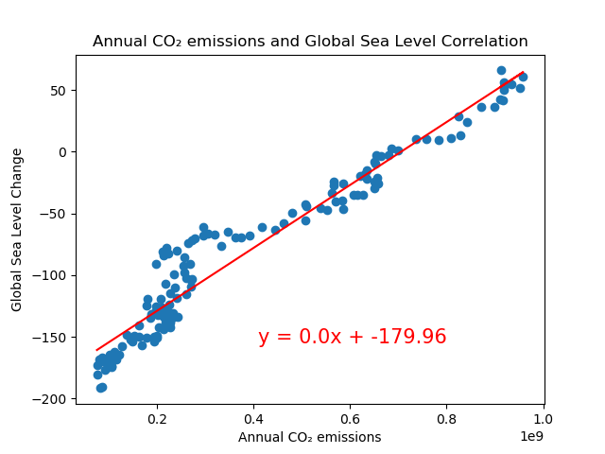
EMISSIONS vs SEA LEVEL ANALYSIS
Emissions vs Sea level
Scatterplot & regression between CO₂ emissions and sea level changes, we see a strong relationship.
R² value of 0.9205 suggests 92% of the var in global sea level changes can be explained by CO₂ emissions.
The other 8% of the var in sea level changes might be due to other factors ( temperature, ice sheet dynamics, ocean circulation changes, or other environmental influences).
Notes:
Based on a scatterplot and regression made between CO2 emissions and sea level changes, we can see there is an indication of a strong relationship between the two. The R^2 value of 0.9205 (approx.. 0.92) suggests that 92% of the variance in global sea level changes can be explained by global CO2 emissions. The remaining 8% of the variance in sea level changes is likely due to other factors not accounted for by CO2 emissions alone, such as temperature, ice sheet dynamics, ocean circulation changes, or other environmental influences.

Slide 7
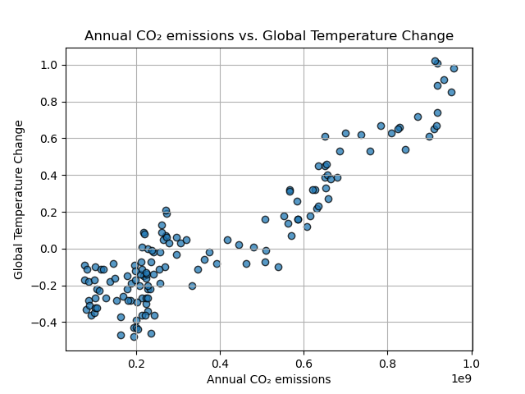
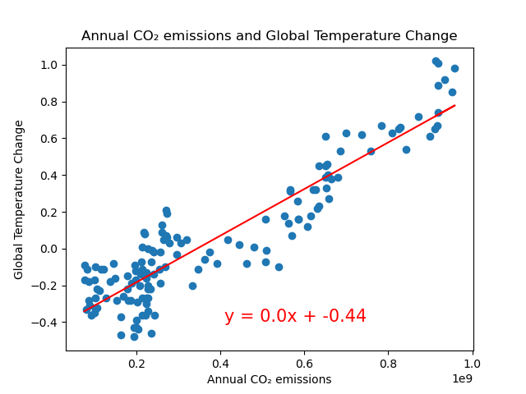
EMISSIONS vs TEMP ANALYSIS
Emissions vs Temperature
Scatterplot and regression for CO₂ emissions and global temperature, show a strong correlation with an R² value of 0.8452 (approx. 0.85).
The variation in global temperature changes can be explained by the changes in CO₂ emissions.
The remaining 15% of the temperature variation could be influenced by other factors such as natural climate variability, volcanic activity, etc.
Notes:
Looking at the scatterplot and regression for CO2 emissions and global temperature, we again see a strong correlation with an R2 value of 0.8452 (approx. 0.85) indicating a strong correlation between the CO2 emissions and global temperatures. Specifically, 85% of the variation in global temperature changes can be explained by the changes in CO2 emissions. This suggests that CO2 emissions are a major cause of temperature increases. This high R2value further reinforces the idea that as CO2 concentrations in the atmosphere rise, global temperatures also tend to increase due to the greenhouse effect. However, like with the previous comparison, the remaining 15% of the temperature variation could be influenced by other factors such as natural climate variability, volcanic activity, etc.

Slide 8

SUMMARY
Link Between CO2 Emissions, Global Temperature, and Sea Level Rise
Sea Level & Global Temperature:
A strong positive correlation is observed (R2 = 0.83), with 83% of sea level variation explained by global temperature changes.
CO2 Emissions & Sea Level:
A very strong correlation exists (R2 = 0.92), with 92% of sea level variation explained by CO2 emissions.
CO2 Emissions & Global Temperature:
A strong correlation (R2 = 0.85), indicating CO2 emissions significantly contribute to global temperature rise.

Slide 9

CONCLUSIONS
As CO2 emissions rise, both global temperatures and sea levels increase, showing a clear, interconnected trend since 1880.
The analysis covers data from 1880 to 2020, highlighting that the most pronounced changes in both temperature and sea level have occurred in the latter half of this period.
This period coincides with industrialization and the significant increase in human caused CO₂ emissions.

Slide 10

DATA RESEARCH
Gathered data and information from diverse online sources
Searched for existing datasets
Downloaded and imported the necessary datasets
CITATIONS
NOAA Climate.gov (2022) – processed by Our World in Data. "Average of Church and White (2011) and UHSLC" [dataset]. NOAA Climate.gov, "Climate Change: Global Sea Level" [original data].
Global Carbon Budget (2023) – with major processing by Our World in Data. “Annual CO₂ emissions – GCB” [dataset]. Global Carbon Project, “Global Carbon Budget” [original data]. Source: Global Carbon Budget (2023) – with major processing by Our World In Data.
Jones et al. (2024) – with major processing by Our World in Data. "Share of contribution to global warming" [dataset]. Jones et al., "National contributions to climate change 2024.1" [original data]. Retrieved November 18, 2024 from

Slide 11

QUESTIONS?
We thank you for your attention during our presentation on Global Climate Change. We hope you found our findings informative and insightful.

